Slide 1
Practicing and Teaching Reproducibility and Replicability in the Human-Environment and Geographical Sciences
Joseph Holler – Middlebury College
Peter Kedron – Arizona State University
Emily Zhou – Middlebury College
Notes:
Peter is travelling to the global conference on economic geography in Dublin, Ireland

Slide 2

Support
NSF BCS-2049837 Transforming Theory-Building and STEM Education Through Reproductions and Replications in the Geographical Sciences
-UCGIS
Geospatial Software Institute - COVID-19 Fellows University of Illinois Urbana-Champaign National Science Foundation OAC-1743184

Slide 3

Introductions
Name
Institution
Research or teaching project related to R&R

Slide 4

Reproducibility & Replicability (R&R)
Reproducibility: Obtaining consistent results using the same input data, computational steps, methods and code, and conditions of analysis
Replicability: Obtaining consistent results across studies aimed at answering the same scientific question, each of which has obtained its own data

Slide 5
Practicing R&R
Adopting reproducible research practices
Conducting reproduction / replication studies

Slide 6
Teaching R&R
Teaching competencies for practicing reproducible research
Conducting reproduction and replication studies with students in…
Methods courses
Independent or small group studies
Research assistantships
Teaching geographic concepts and methods through reproduction and replication studies

Slide 7
Today’s Seminar Objectives
Overview of R&R in Human-Environment and Geographical Sciences
Research compendium in Git / GitHub
Plan and register a reproduction / replication study
Execute a computational notebook in Rstudio / R Markdown
Share & discuss experience & vision for R&R
We welcome feedback on all materials shared today! Email, GitHub Issue, or Pull Request!

Slide 8
Our Research Objectives
Assess reproducible research practices in the geographical sciences and identify barriers to reproducibility.
Assess the credibility and generalizability of recent high-impact HEGS research by conducting reproductions and replications.
Establish and evaluate a pedagogy that uses reproductions and replications to improve student learning and STEM competencies.
Notes:
Survey is out!
Seven reproduction studies
Two replication studies
Undergraduate Open Source GIScience course; Graduate spatial statistics course; Graduate reading group; Seven ind. studies / RAs

Slide 9
State of the Research: Year One
Curriculum: https://gis4dev.github.io *find learning resources here!
Seven reproduction / replication studies:
https://osf.io/c5a2r/ and https://github.com/HEGSRR
Kedron, P., and J. Holler. 2022. Replication and the search for the laws in the geographic sciences. Annals of GIS 28 (1):45–56.
A Replication of Dimaggio Et Al. (2020) in Phoenix, AZ.
Annals of Epidemiology
Moving Beyond Computation: Reproducing Geographical Analyses of COVID­19 to Assess and Improve the Validity of Research
Geographical Analysis

Slide 10
Findings from Reproductions
Every study can be improved: reproducibility can be constructive!
The basic components needed to reproduce studies were not available
Metadata was missing and seems to have not been closely examined by some authors
There is a clear need for true interdisciplinary work that balances domain knowledge with expertise in spatial analysis
Spatial analysis decisions were often weakly justified and not carefully examined
The selective inference problem makes it unclear how reliable even reproducible studies are

Slide 11
Part I: Overview of R&R in HEGS
Vignette: Spatial Accessibility in Illinois
R&R illustrated in context of COVID-19 pandemic

Slide 12
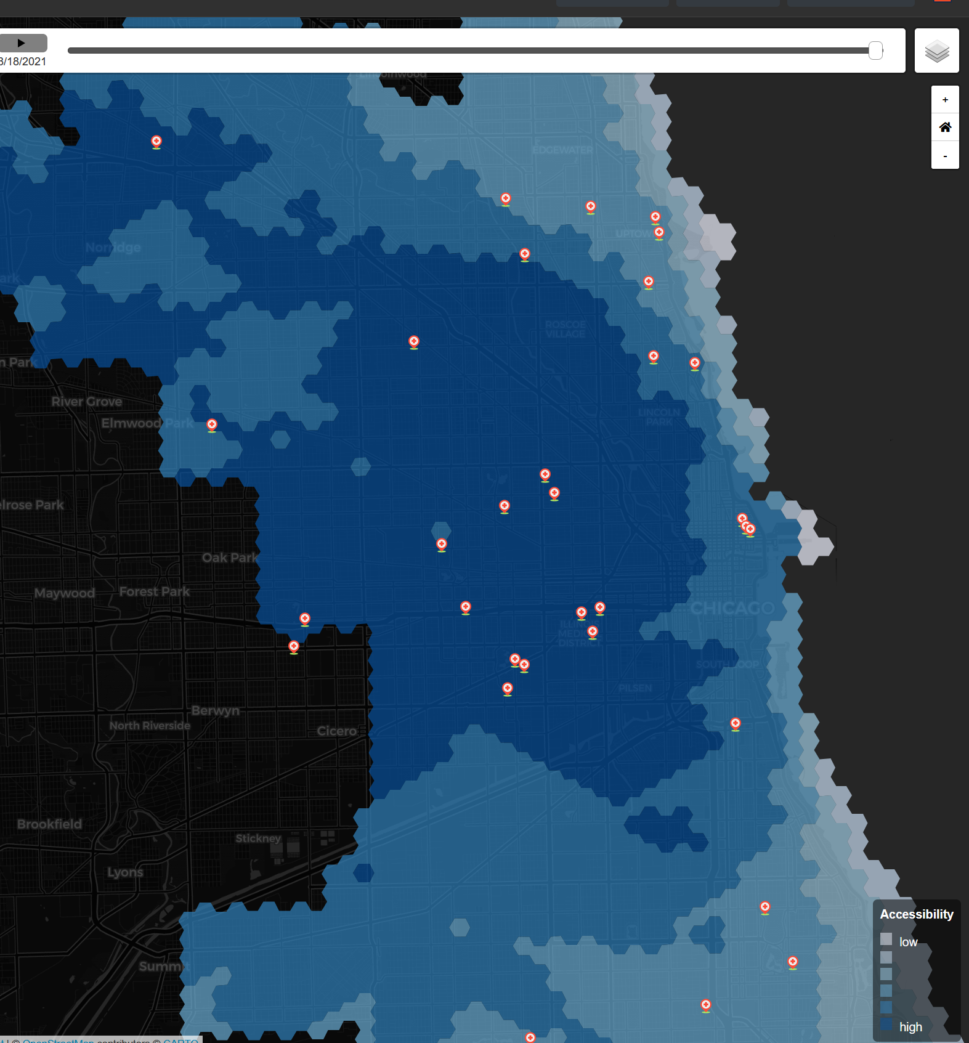
Vignette: Spatial Accessibility in Illinois
Kang, J. Y., A. Michels, F. Lyu, Shaohua Wang, N. Agbodo, V. L. Freeman, and Shaowen Wang. 2020. Rapidly measuring spatial accessibility of COVID-19 healthcare resources: a case study of Illinois, USA. International Journal of Health Geographics 19 (1):1–17. doi.org/10.1186/s12942-020-00229-x.

Slide 13
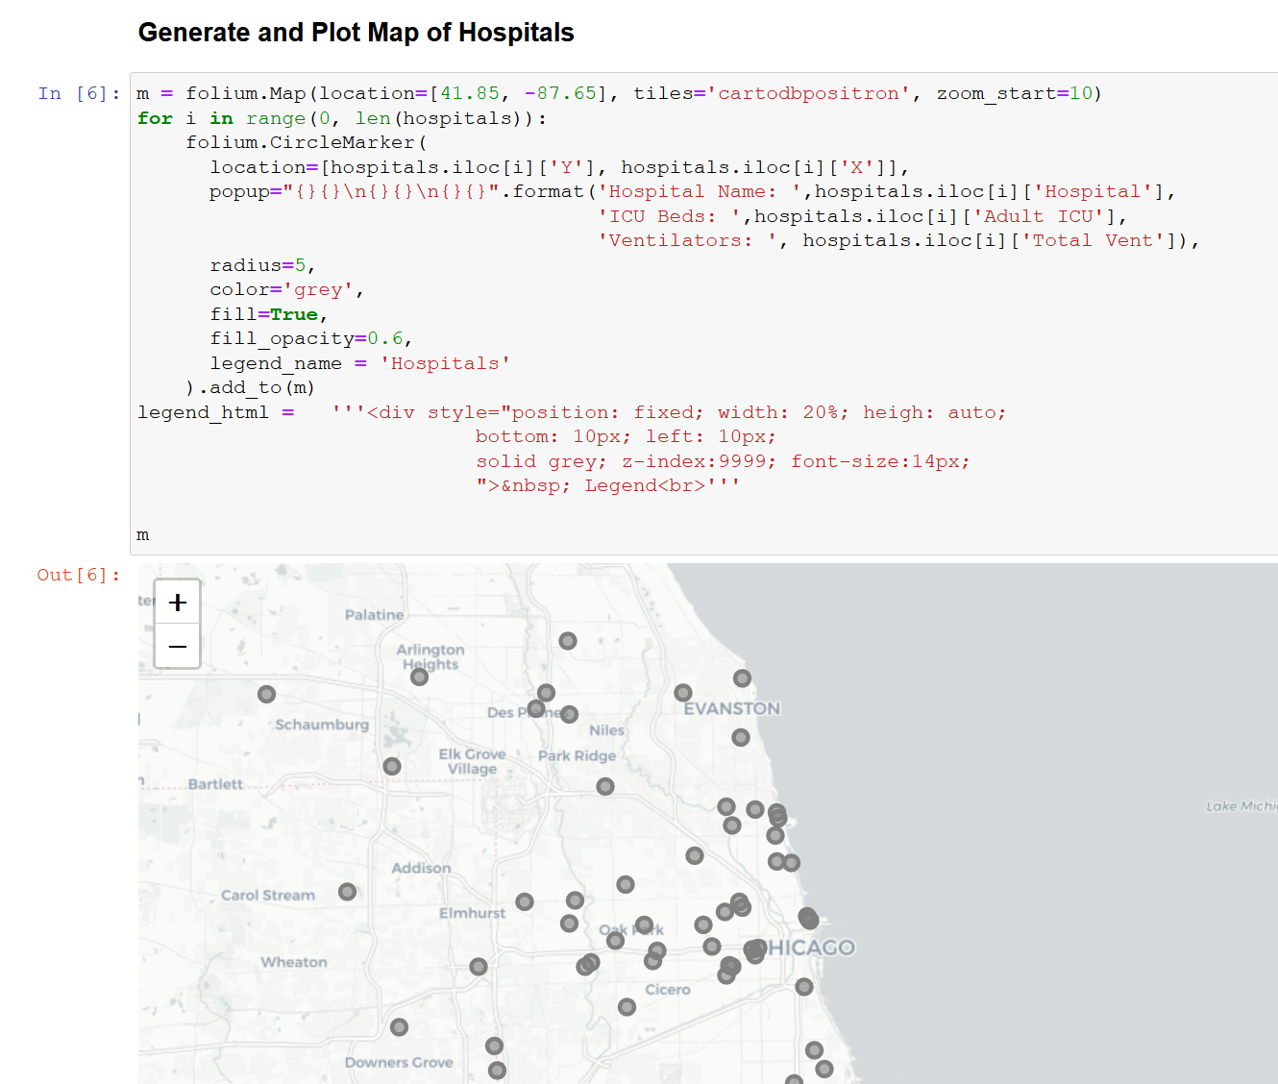
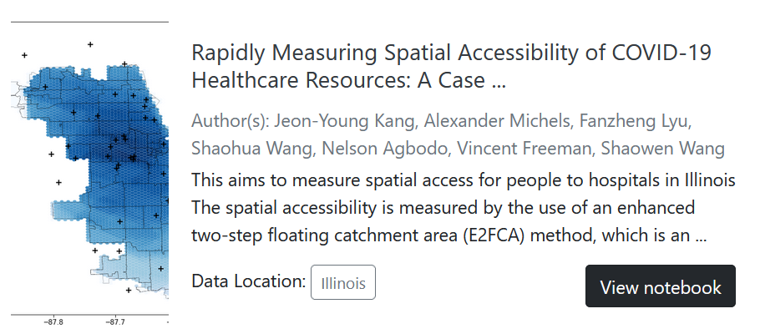

Reproduce Studies with Jupyter Notebook on CyberGISX
https://cybergisxhub.cigi.illinois.edu/wherecovid-19/
Notes:
Parallel to the journal publication, the authors published a Jupyter computational notebook
There is a one-click procedure for cloning and opening the notebook on the CyberGISX platform; a cyber GIS high performance computing server and community
Computational notebooks are a huge asset for reproducibility because they interweave narrative with text and outputs;
On the right you can see an illustration of the computational notebook with a narrative heading, python code for mapping hospitals, and the produced slippy map of hospitals in the Chicago region.
In this workshop, we will use the R language equivalent of a computational notebook: RMarkdown

Slide 14
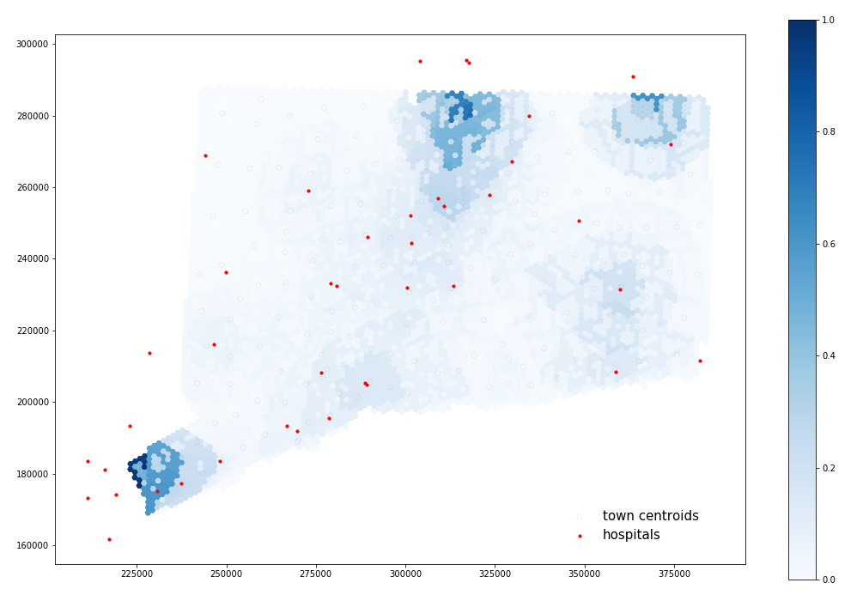
Fall 2020: Derrick Burt Reproduces and Replicates
Reproduction of Chicago succeeds
Reproduction of Illinois fails due to network size
Replication in Connecticut with town-level COVID-19 data
Notes:
In fall of 2020, Derrick Burt completed an independent study by attempting to reproduce and replicate the notebook using CyberGISX.
He succeeded in reproducing results for Chicago,
But failed to reproduce results for Illinois due the file size and resources required to process road networks for the full state of Illinois
Changing tacks, he acquired COVID data at the town level for Connecticut and succeeded in replicating the study for that state

Slide 15
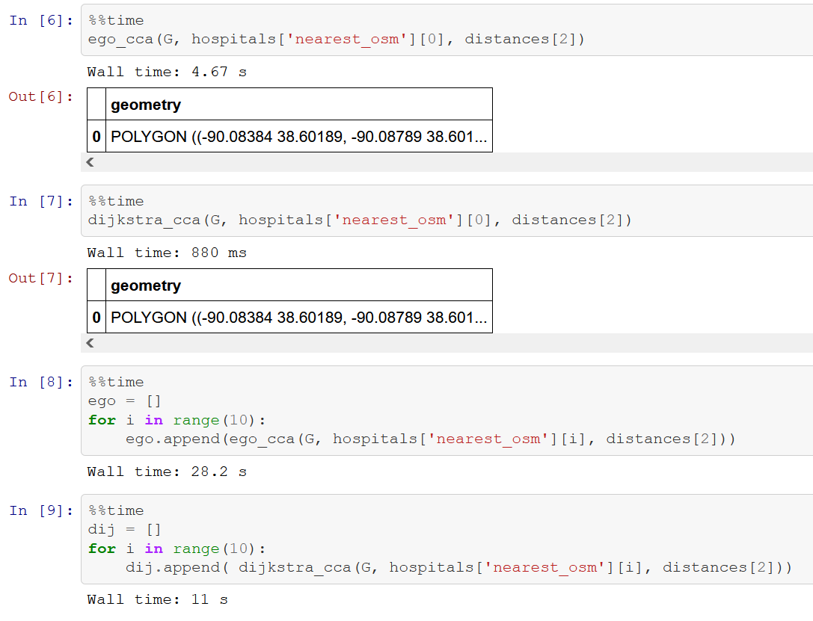
January 2021: Kufre Udoh Reanalyzes
Local python environment
Update osmnx and networkx packages
Replace ego_graph() with subgraph()
See time comparisons!
Notes:
In January of 2021, Kufre completed an independent study reanalyzing the original notebook…
Set up python environment on his local computer
With updated osmnx and networkx packages for acquiring openstreetmap road data and for network analysis
New package versions required modified function calls
Replaced egograph function with subgraph function to improve performance by making a virtual “VIEW” subset of the network graph without generating a completely new copy of the subgraph
Kufre’s code on the right shows savings of more than half the processing time

Slide 16
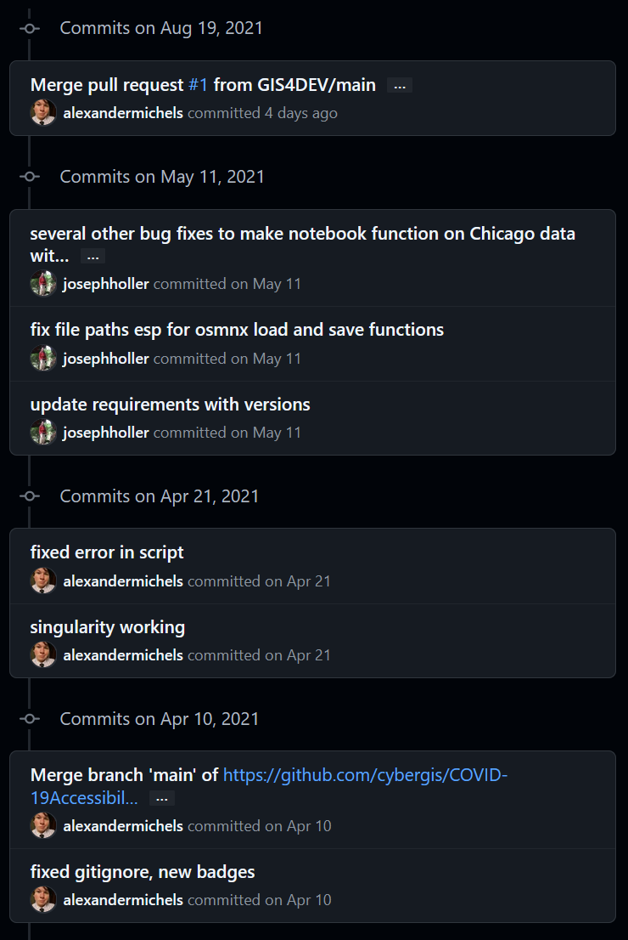
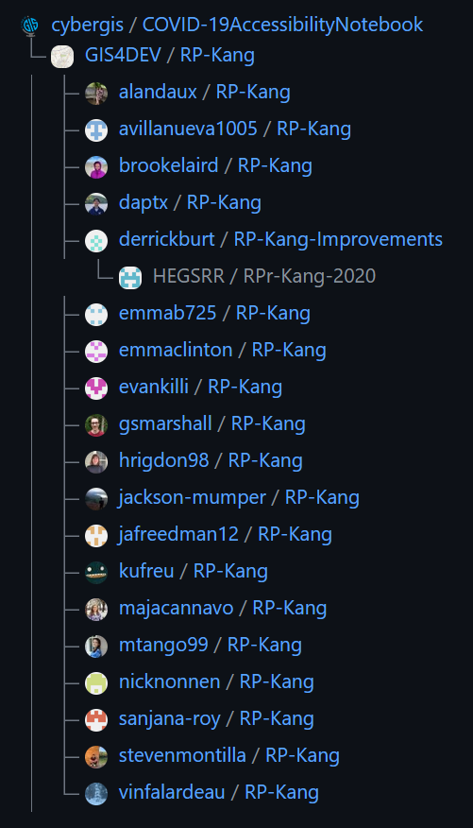
Spring 2021: Reproduce with class
Alexandermichels revises notebook to focus on Chicago
Holler fixes bugs in notebook
17 Middlebury students reproduce the study for Chicago
Twenty novice & experienced GIScientists have now run the notebook
GitHub tracks networks & history of contributions
Notes:
At this juncture, I hope that you’re starting to get a sense of the open science potential of CyberGISX and our reproducibility work.
Based on our feedback about Illinois, the authors revised the notebook to focus on Chicago
The revisions inadvertently created some new bugs and conceptual problems.
As teaching prep in the spring, I fixed most of the bugs and sent the fixes back to the authors in the form of a pull request.
Meanwhile, 17 Middlebury students forked the repository, cloned it to their own CyberGISX accounts, reviewed the methodology, and published reports with ideas for improvements, and some implementations.
All of this collaboration is facilitated by GitHub, where the history of changes and forks of the repository are also visible, as shown on the right.

Slide 17
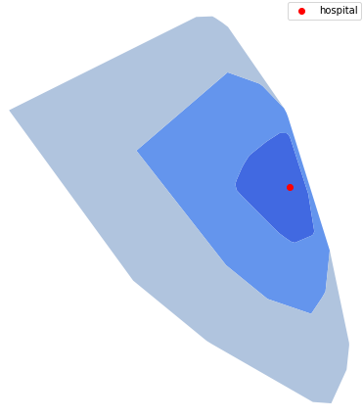
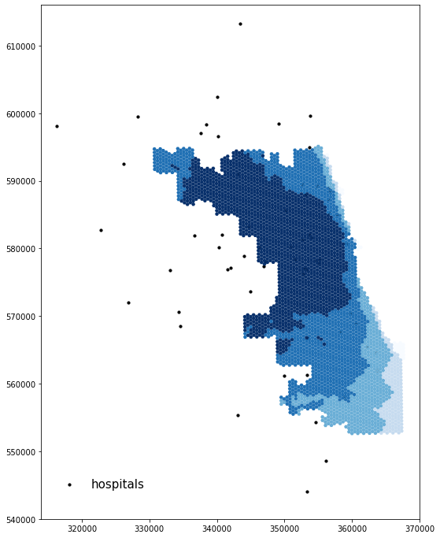
Summer 2021: Derrick Burt Reanalyzes
github.com/HEGSRR/RPr-Kang-2020
Apply HEGSRR Template & USGS Metadata Wizard 2.0
Preprocess data (-ventilators)
Create figures in paper (histogram, classified map)
Credibility/Legibility: Vignette/visualize a single hospital; check speed data (mostly NULL; new error)
Improve Accuracy: 30mph urban speed; errors in new OSM data, edge effects
Improve Efficiency: Replace three iterations of Dijkstra’s Shortest Path for each hospital with one
Compare original and reproduction results: correlation and scatterplot
Notes:
This summer, Derrick reanalyzed the notebook as a research assistant
He applied our HEGSRR Template for reproducible research to the notebook contents and used the USGS Metadata Wizard 2.0 to document metadata to open standards.
His revision to the research methodology included:
Code to increase the reproducibility of data by downloading and preprocessing as much as possible
Code to increase the reproducibility of figures in the original publication, including histograms for each service/population combination and classified accessibility maps with the same aesthetics
Code to increase the credibility and legibility by creating a vignette of the hospital catchment areas (top left) and adding in checks for the input data, especially openStreetMap speed limits
Revisions to increase accuracy by using the Illinois speed limit for municipal areas, accounting for new errors introduced by users of OpenStreetMap (a data source that is always changing), and to account for edge effects where the floating catchment area really needs road and population data in a buffer of up to two times the maximum distance, and the hospital setting algorithm was snapping hospitals to the nearest network node, virtually moving suburban hospitals into the city limits
We increased the efficiency of the computationally intensive processing, using the subgraph() function mentioned earlier and by reorganizing the code and graph structure allow us to call the dijkstra’s algorithm just once for each hospital, rather than three times. On a recent afternoon, these changes reduced processing time to calculate catchment areas by 80%, from 7 minutes 40 seconds to 1 minute 30 seconds
Finally, we added code to load results from original notebook and quantitatively compare with correlation analyses and scatterplots

Slide 18
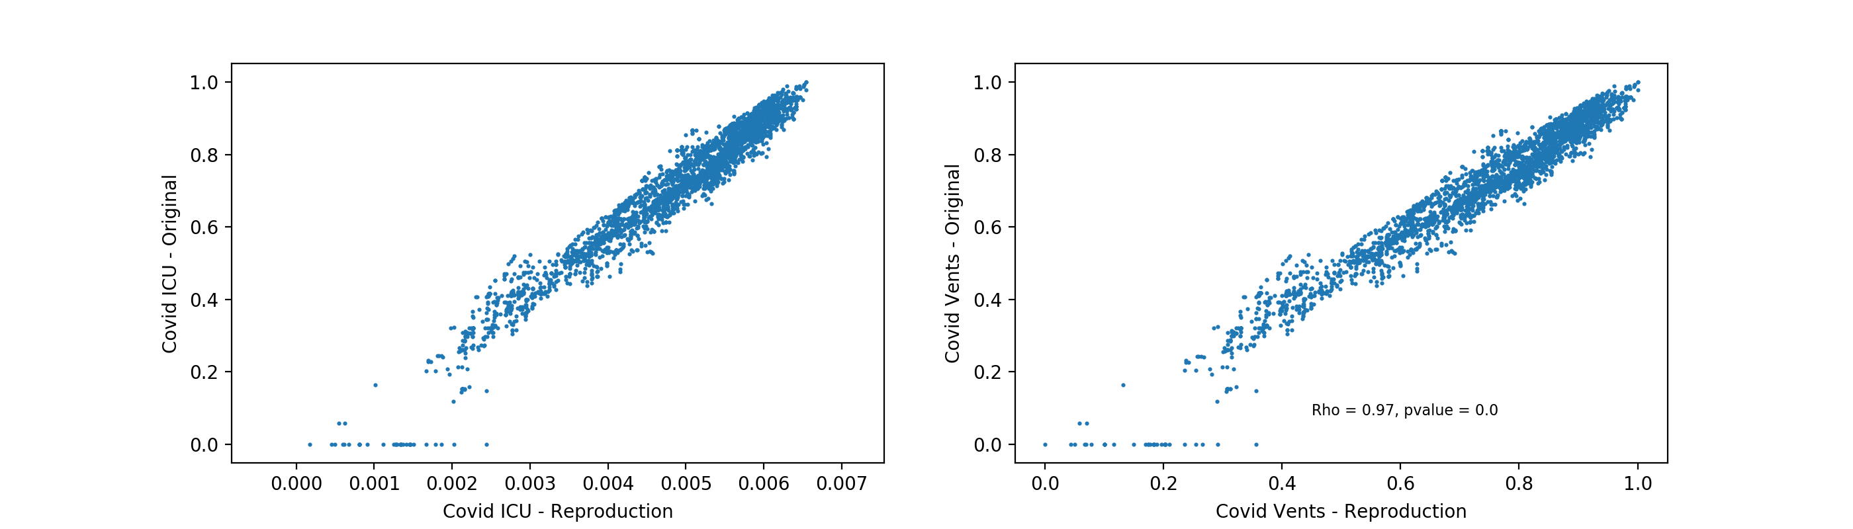
Successful Computational Reproduction
CyberGISX provides a collaborative scholarly community of GIScientists and students
Future work:
New osmnx functions for network pre-processing
Improve construction of catchment area polygons
Use geopandas spatial indices for overlap analysis
Implement social vulnerability analysis
Create data structure to store hospital catchment areas as collection of hexagonal grids
Notes:
In sum, we achieved successful computational reproduction with Spearmans Rho of .97, foiled mainly by edge effects on Lake Michigan.
The Cyber GISX platform provided a collaborative scholarly community of GIScientists and students
Future work to improve this notebook could include…

Slide 19
Reproducibility & Replicability in the Geographical Sciences
Illustrated with COVID-19 Pandemic Research

Slide 20
Science
Science builds explanatory structures, tells stories which are scrupulously tested to see if they are stories about real life. -Medawar 1967
Science is about finding the most reliable way of thinking at the present level of knowledge. -Rovelli 2014
Notes:
Explanations and knowledge do change over time; we rely on science to build trust & reliability in our beliefs about the world
We content that as a community, science relies on ability to design studies to test theory, clearly communicate methods and results, independently repeat the studies in a variety of contexts to refine understanding, correct errors, build credibility, and reject false understandings

Slide 21
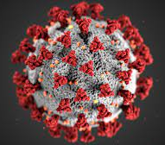
Science Under Stress: COVID-19
Reproducibility Crisis
Reproducibility rules @ Environmental Protection Agency & Office of Budget Administration
Knowledge evolving rapidly
Open access preprint repositories medRxiv, bioRxiv
Accelerated peer review and publishing process
Retractions from hasty science?
Hydroxychloroquine, Surgisphere, The Lancet & New England Journal of Medicine
An alarming retraction rate for scientific publications on Coronavirus Disease (Yeo-Teh and Tang 2021)
Crisis of public trust?

Slide 22
(How) Do we trust science?
Community with self-corrective mechanisms
Peer Review
Debate / test alternative hypotheses – Kuhn’s paradigm shifts
Internal validity
External validity
Reliability
Credibility
Notes:
Internal validity: logical consistency, model assumptions, accuracy assessment, uncertainty assessment, construct validity
External validity: the study can be independently verified
Reliability: Inferential power of the study is proven over the course of many studies over time
Credibility: both valid and trusted

Slide 23
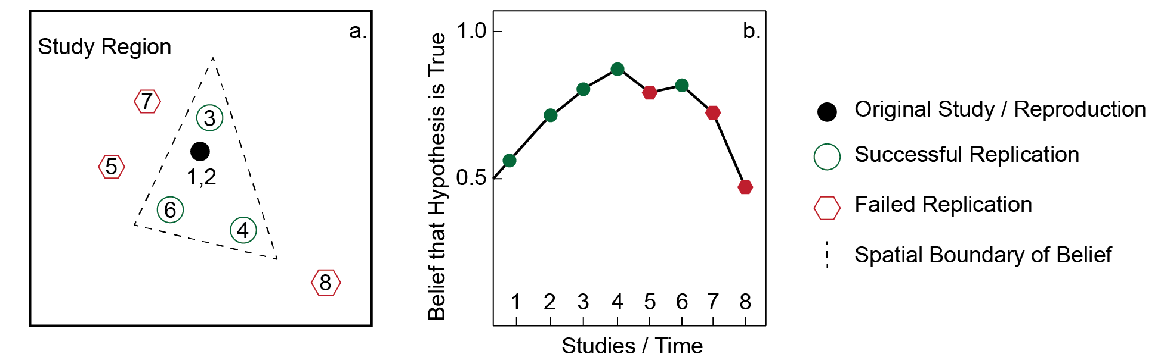
Spatial Autocorrelation, Heterogeneity & Scientific Discovery
Kedron, P., and J. Holler. 2022. Replication and the search for the laws in the geographic sciences. Annals of GIS 28 (1):45–56.
Notes:
We cannot believe in a theory from just one study
Needs accumulation of evidence over multiple studies
Nearby studies may succeed simply because of spatial autocorrelation
Mechanisms may only hold within certain geographic contexts, in which case you need enough studies to specify the context

Slide 24
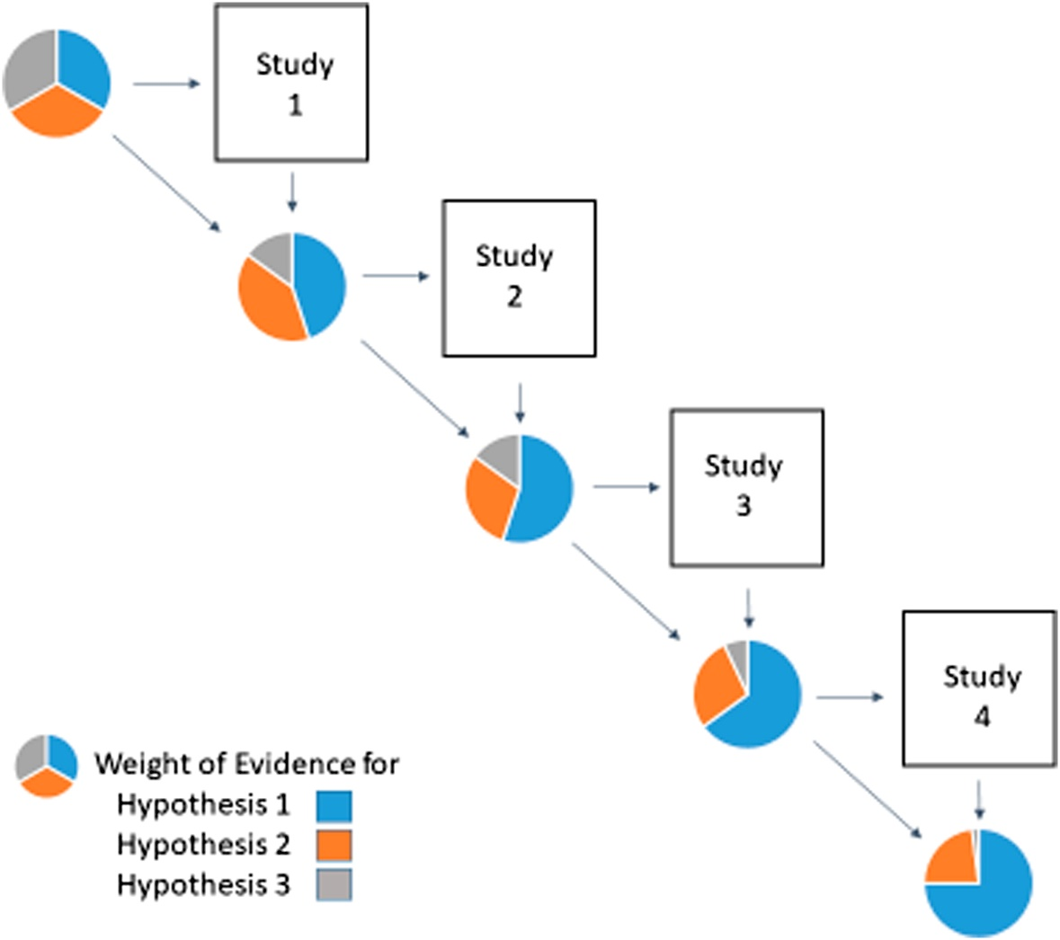
Accumulation of Evidence
Nichols, J. D., M. K. Oli, W. L. Kendall, and G. Scott Boomer. 2021. A better approach for dealing with reproducibility and replicability in science. Proceedings of the National Academy of Sciences of the United States of America 118 (7):1–5.
Notes:
Nichols and other in PNAS suggest a Bayesian approach to designing a series of studies to hone in on the truth based on probabilities of alternative hypotheses

Slide 25
Reproduction for Credibility & Scientific Progress
 | Same Methods | Varied Methods
Same Data | Reproduction (Verification) | Reanalysis
Different Data | (Direct) Replication | Extension
Modified from Christensen, Freese and Miguel (2019, Table 9.1 pg 159)
Notes:
In truth, we have never strictly reproduced a study… and formulation of new studies in science is not spurious / unrelated to previous work.

Slide 26


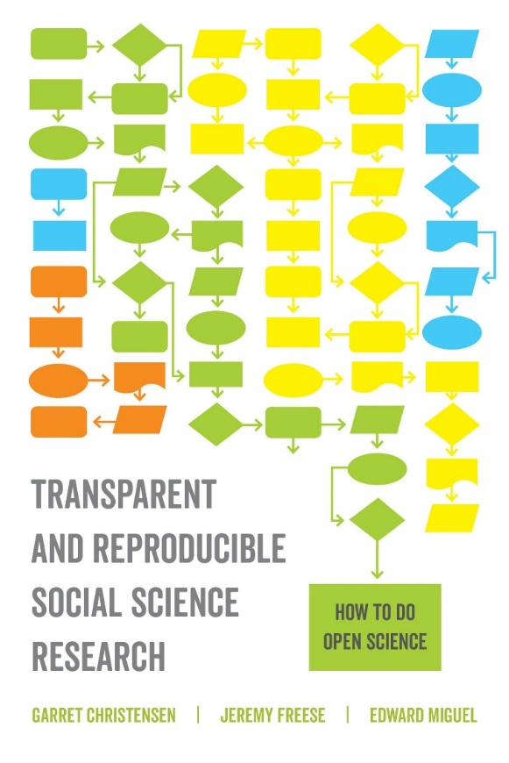
Literature: Highlights

Slide 27
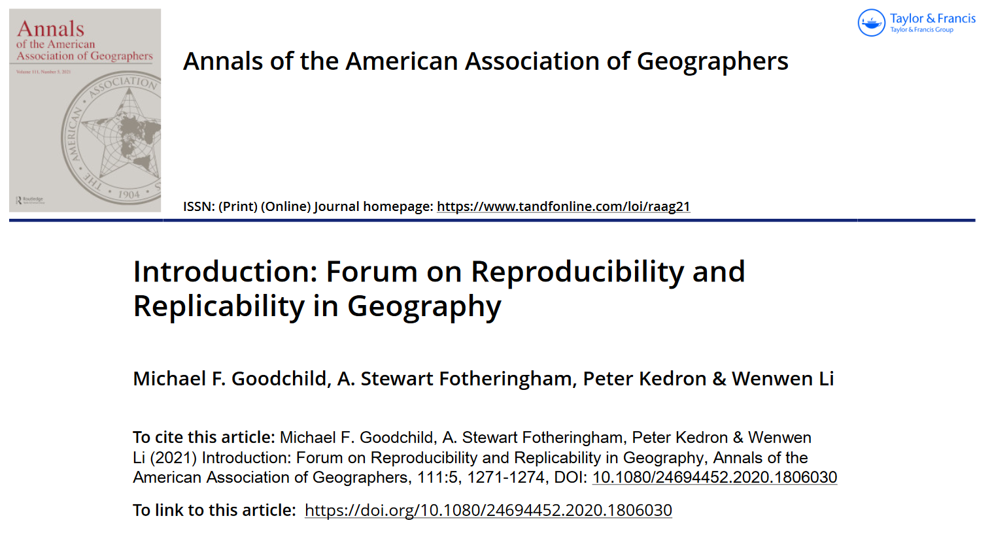

R&R in Geography: Highlights

Slide 28
R&R in Geography: Highlights
Computational reproducibility: AGILE, GIScience, VGI
Ostermann, Granell, o2r team
Executable research compendia & containerizing processing environ.
o2r: Konkol, Kray, Nüst, Pebesma
Open GIScience / Open Source GIS
S. Rey, D. Sui, A. Singleton, S. Spielman, C. Brunsdon, C. Farmer, H. Mitasova
5-star guide: open standards & metadata: Wilson et al
Provenance / privacy / data quality: Tullis & Kar
Epistemology and Reproducibility: Wainwright; D. Sui and P. Kedron
Data Repository: Mei Po Kwan, D. Richardson

Slide 29
Practical & Computational Reproducibility

Slide 30

Many necessary conditions for Reproducibility

Slide 31
Improving R&R
Practices
Publishing / Disseminating
Preregister research plan
Data
raw, preprocessed, and results
Code
computational notebook
legibility
Processing environment
Open source software
Specify or containerize environment
Version tracking, living papers
FAIR (findable, accessible, interoperable, reusable) principles
Metadata
Overall project, and all components
Open Licenses
Persistent identifiers (e.g. DOI, ORCID)

Slide 32







Infrastructure
Curricula / pedagogy
Git, GitHub, Markdown & Jekyll
Template Repository
OSF / Figshare
Python Jupyter Notebooks / R Markdown
Docker, o2r.info
Cyberinfrastructure, e.g. CyberGISX
Data repository with access based on ethics review
R&R publishing guidelines / article types / exemplar studies
Notes:
Github & Git: Version tracking, collaborative platforms for projects & coding, website rendering & serving with Jekyll
Open Science Foundation – register preanalysis plans, reports, preprints, data, code, GitHub integration
Python Jupyter Notebooks; R Rmarkdown – computational notebooks, computing languages of data science with robust spatial extensions
Docker – containerize the computational environment
Cyberinfrastructure – shared high-performance computing environment for running Jupyter notebooks

Slide 33
R&R Pedagogy

Slide 34
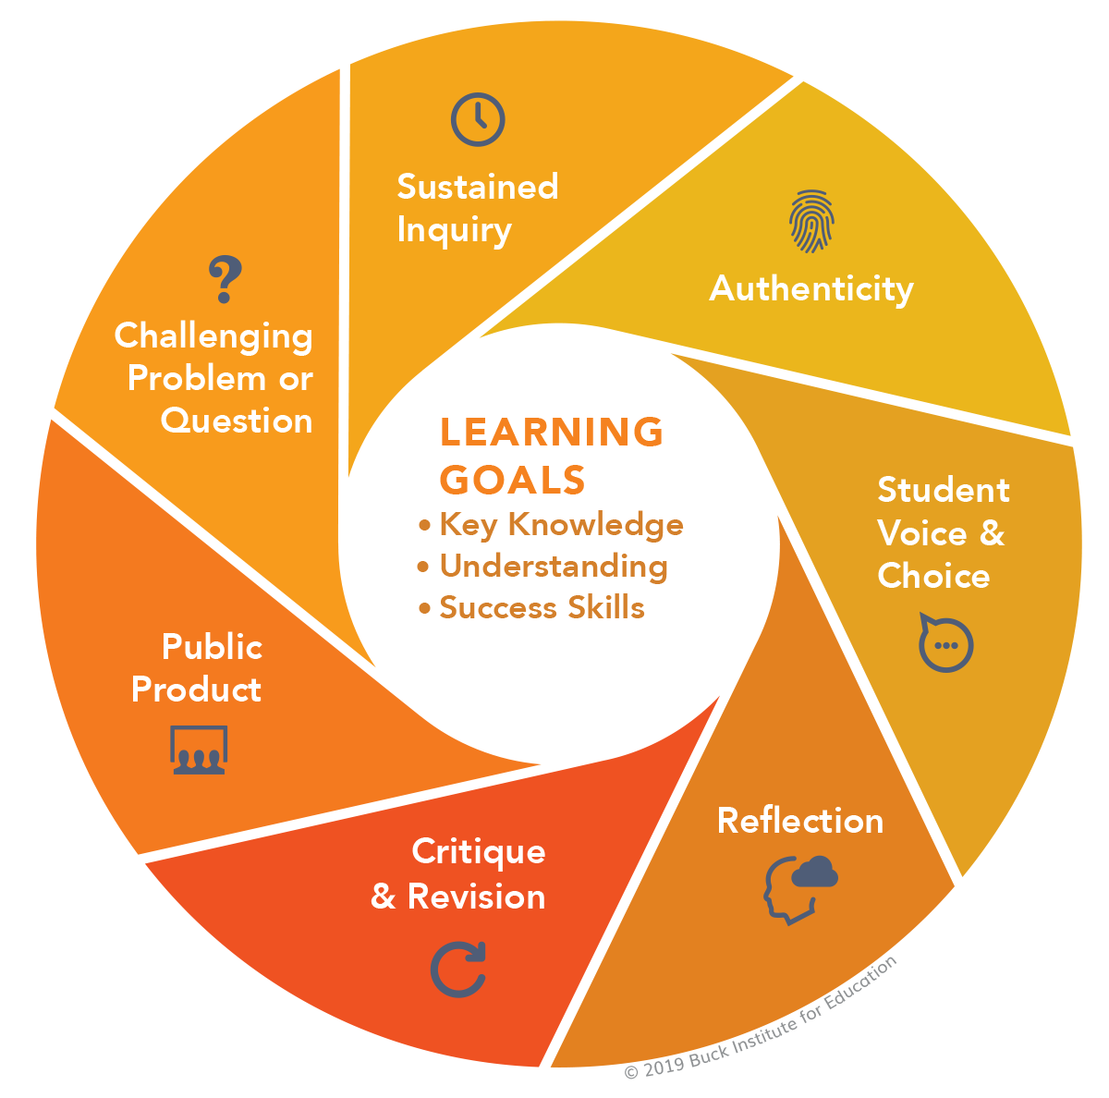
Project-Based Learning
Reproduction studies as project-based learning
Refocus learning goals on competencies
Improved engagement
Retain diversity in STEM
Share motivations with students!
PBL Gold Standard: https://www.pblworks.org/what-is-pbl/gold-standard-project-design

Slide 35
Rethinking Learning Goals
Software-specific methods & extensions? No…
Typical GIS Project: theme, geodatabase & some maps
Learn and practice competencies for:
Reading published research
Research planning / design
Learning new (open source) software
Comparing results / assessing error and uncertainty
Reporting findings

Slide 36
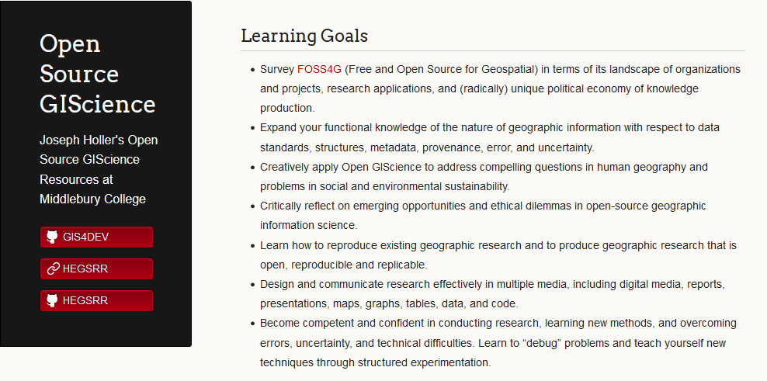
Open Source GIScience @ GIS4DEV.github.io
Notes:
Open access curriculum; advanced undergraduate course at Middlebury
Links to student work, including Emily’s excellent pages
Built with GitHub Sites using Jeckyll theme
Many links to resources, including how to create these pages.

Slide 37

Discuss
Reproducibility takes work to achieve… (as if publishing research is not work enough)
Why should we try? What are our individual and collective motivations?
Any failures, concerns, misgivings?

Slide 38
Vision for R&R in Geography
Studies are preregistered, conducted with open source software, published with permissible licenses, and attached to executable compendia
Reproduction and replication studies are encouraged and published by preeminent journals
Students learn contemporary methods and classic theories through reproductions and replications
Students conduct and publish reproductions and replications, developing their methods while contributing to geographic sciences.

Slide 39

Break
Have you created a GitHub account?
Have you installed GitHub Desktop?

Slide 40
Part II: Research Compendium in Git & GitHub
GitHub Overview
Template for R&R Research in HEGS

Slide 41
GitHub Overview

Slide 42
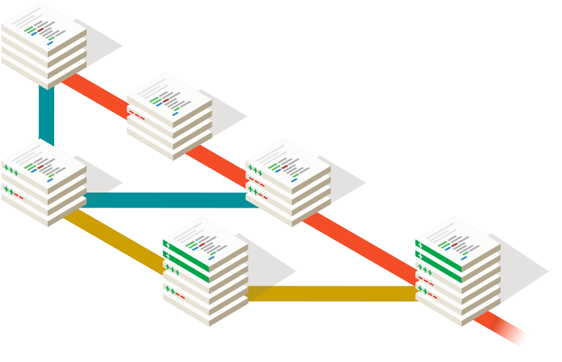

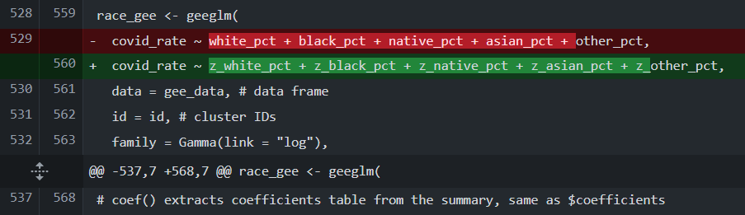
Challenges
Many versions of a research project over time
Complex project management, especially with alternative possible solutions
Collaborating with peers, research assistants
Tracking contributions to the research
Publishing / disseminating research compendium
… GitHub is a software company implementing open source Git

Slide 43
Git & GitHub Version Control
Command | Purpose
Clone | Download repo from GitHub to your computer
Fork | Copy repo into your remote GitHub account
Commit | Make a set of changes to a repo
Revert | Undo a commit
Fetch | Download remote commits from GitHub
Pull | Download & apply remote commits from GitHub
Push | Upload local commits to GitHub
Branch | Create a new distinct set of commits
Pull Request | Suggest, review & merge a fork or branch

Slide 44

GitHub Features
Publishing: Markdown pages, GitHub pages with Jekyll
Credit: LICENSE file and .CFF citation file
Collaboration: Issues, Discussions, Wikis, Pull Requests
Control & Organize Access: Public/Private, Organizations, Teams
Version Releases: 1.0 Preanalysis, 1.1 Preprint, 1.2 Review…
Difference visualization
Free Services for GitHub Educators / Campus Advisors
Integrations: Overleaf, OSF, RStudio, Atom …

Slide 45
Tips, Tricks & Limitations
Start Git repository with collaborators at project conception
Commit frequently with good descriptions
Use plain-text data formats
Markdown LaTeX rather than Microsoft Word
XML, CSV, JSON rather than Shapefile
One sentence on each new line
No files > 100mb
Never hard code passwords or API keys into your code
Clear Jupyter notebook contents before committing changes

Slide 46
Template for R&R Research in HEGS

Slide 47
(Executable) Research Compendium
Computational Notebook: Narrative and Code
Data
Processing Environment
Metadata
License
Code executes/compiles into publication

Slide 48
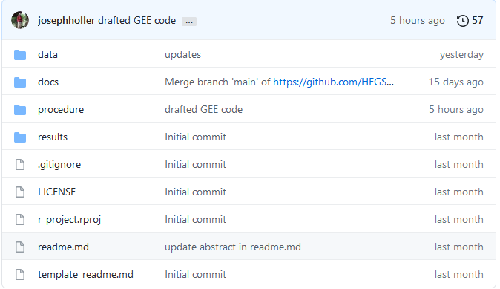
Repository template for HEGS research
github.com/HEGSRR/ HEGSRR-Template
Standard folder and metadata structure
Template study pre-registration (original, reproduction, or replication)
Reporting guidance that links preregistration with results
Rmarkdown & Jupyter templates …
Integral to our pedagogy
Notes:
Preregistration Template
Prereg template is modelled on OSF and other repositories, but adds in critical project-level metadata needed to understand HEGS research (e.g., spatial study area info, spatial analytical choices).
We have also found that this prereg template severs an important pedagogical function when work with students to attempt reproduction because it guides students through the deconstruction/evaluation of existing work.
Folders/Metadata
We viewed this a crucial as all the projects we worked with had different documentation systems (if any at all) and poor data-, analytical-, or project-level metadata.
Essentially, we could not find what people even used to do what they did, or how they did it.
Next Steps
We are now working with Anand to build some starter R and Python templates for those new to CyberGIS
As fellows are completing their work, we are converting their work into this structure as we attempt our reproductions

Slide 49
Use .gitignore and code to manage data
DATA/ | PRIVATE/ | PUBLIC/
RAW/ | ignore
DERIVED/ | ignore
METADATA/
SCRATCH/ | ignore
.gitignore example:
data/raw/private/**
!readme.md
script example:
G = ox.graph_from_place('Illinois', network_type='drive', buffer_dist=24140.2)
ox.save_graphml(G, 'raw/private/ Illinois_Network.graphml')
Notes:
JOE
Our research data includes limitations of size, confidentiality, and legal restrictions.
Therefore, we need a research compendium structure to accommodate restrictions while maximizing reproducibility
We use a root DATA folder with a comma-separated values table to index all of its contents
Data entered into raw folder in its original, unmodified state, then preprocessed into derived data for analysis
Data in the private and scratch folders is igonored by GitHub, and therefore kept only on your local machine
Scripts can download data into the raw/private folder from OpenSteetMap, Twitter rehydration, restricted repositories
Save anonymized / aggregated / simulated / vignette data into derived/public
Computational notebooks should include code for downloading raw private data and transforming it into public derived
All data should have documented Metadata, ideally to FGDC or ISO standards

Slide 50
Practice: Managing GitHub Repositories
Please see the Workshop Technical Guide and follow along

Slide 51
Discuss
Adopting a new technology to manage your scholarship may seem daunting…
Are there any specific ways you want to integrate Git version control into your scholarship?
Are there specific reasons that you wish you had already adopted Git in the past?
Any concerns or misgivings?

Slide 52
Break
Have you seen the original paper for our example reproduction study?
Chakraborty, J. 2021. Social inequities in the distribution of COVID-19: An intra-categorical analysis of people with disabilities in the U.S. Disability and Health Journal 14 (1):101007. doi.org/10.1016/j.dhjo.2020.101007

Slide 53
Part III: Plan and Register a Reproduction / Replication Study
Preanalysis Plan Overview

Slide 54
Pre-analysis Plan Overview

Slide 55
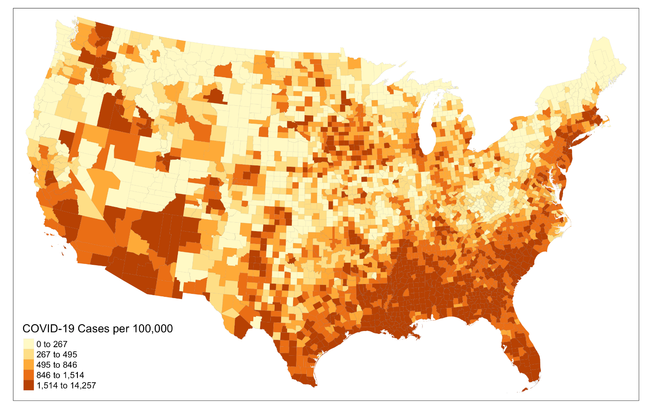
Reproduction study worked example
Chakraborty, J. 2021. Social inequities in the distribution of COVID-19: An intra-categorical analysis of people with disabilities in the U.S. Disability and Health Journal 14 (1):101007.
Notes:
Chakraborty’s paper is commendably concise and precisely written, using public data sources, on a timely topic with implications for policymaking.
Jayit was a willing and helpful participant in the reproduction!

Slide 56

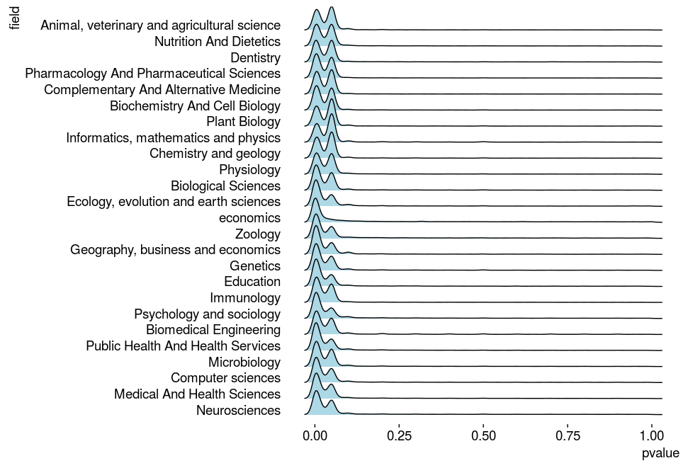

Pre-analysis Planning & Registration
Challenge: P-hacking, Research File Drawer

Slide 57
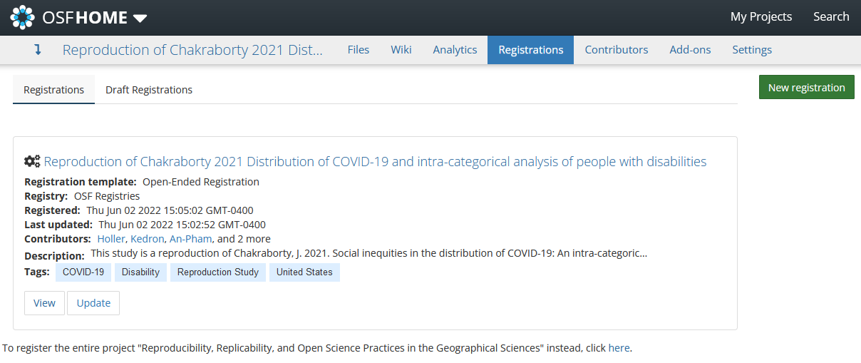
OSF Pre-analysis Plan Registration
https://doi.org/10.17605/OSF.IO/S5MTQ

Slide 58
OSF Pre-analysis Plan Registration
Log in with ORCID
Create a project (public or private)
Link to GitHub repository (Add-ons → GitHub) https://help.osf.io/article/211-connect-github-to-a-project
Go to Registrations → New Registration
Title, Description, Contributors, Category (procedure, project), License (BSD 3-Clause)
Will be archived & appear under “registrations”
Can be embargoed, but not retracted or changed.
Generate DOI for any public OSF project or project component

Slide 59
R&R Pre-Analysis Plan
Original Study Information
Abstract
Geographic extent
Spatial Support
Data sources & their availability
Analytical Plan
Original Data Sampling
Secondary Data
Variables, including attribute or geographic transformations
Analytical specification (e.g. statistical model parameters)
Inference criteria, results & robustness
Protocol & any planned differences from original study

Slide 60
Pre-analysis Planning
Close reading of paper, highlighting
Data Sources / Inputs
Methodology and Data Processing / Methods / Tools
Intermediary and Final Results / Outputs
Research data sources & metadata without viewing data directly
Research / review unfamiliar methods, especially assumptions, inputs, parameters, outputs

Slide 61
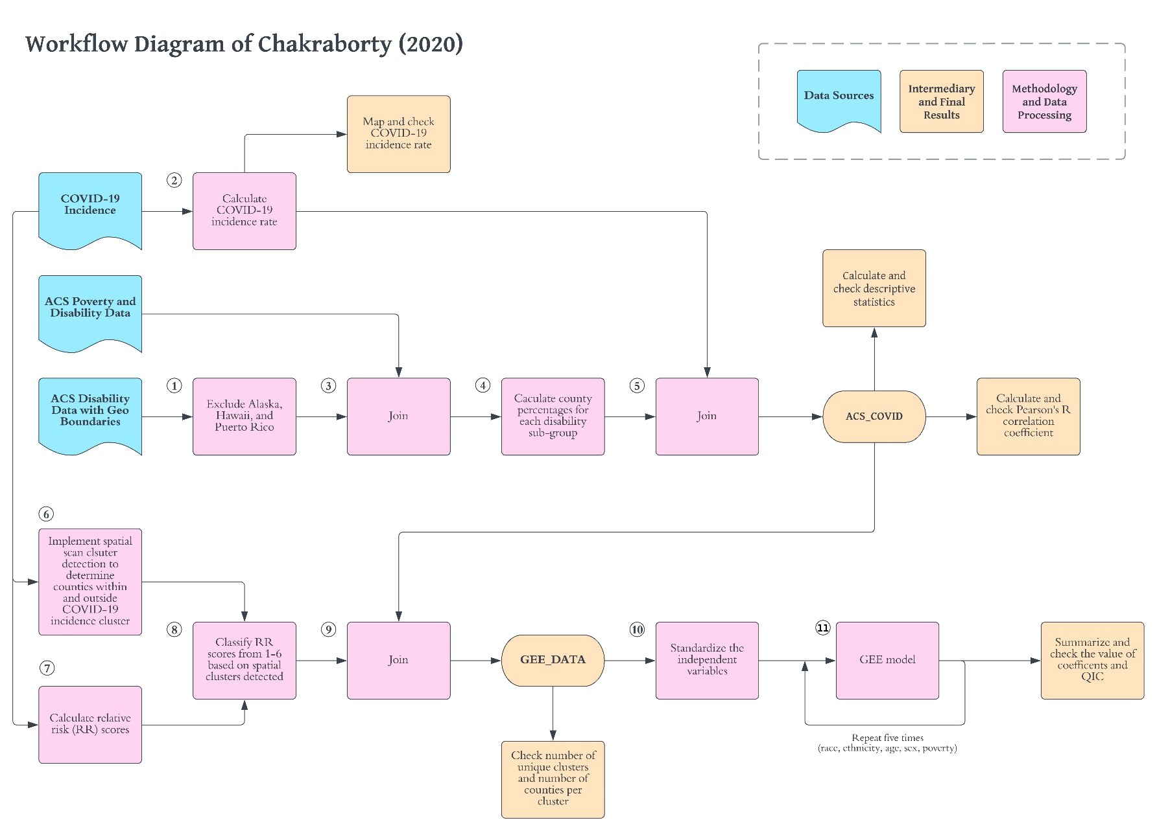
Workflow Diagram
Circular data layers
Rectangular processes
Interactive activity /w notecards & cutout figures

Slide 62
Activity
Gather in small groups
Number each paragraph of the research paper
Annotate the workflow diagram, indicating which paragraphs of the paper contain information about that analytical step or data source
This is why computational notebooks are valuable for reproducibility– interweave narrative and code!

Slide 63
The Spatial Scan Statistic: SaTScan & SpatialEpi

Slide 64

SaTScan
Free
Not open source
Requires three input files and many parameters
https://www.satscan.org
Reproducible?
Requires manual use of multiple programs or…
Requires separate installation of SaTScan and system-specific commands from within R
SaTScan™ is a trademark of Martin Kulldorff. The SaTScan™ software was developed under the joint auspices of (i) Martin Kulldorff, (ii) the National Cancer Institute, and (iii) the New York City Department of Health and Mental Hygiene.

Slide 65
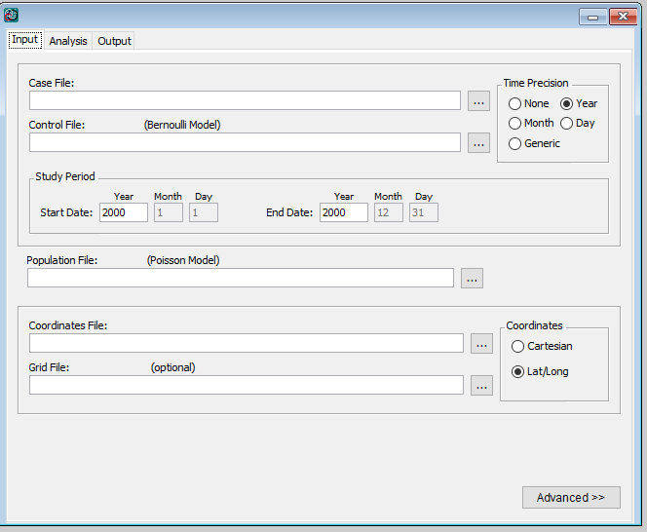
SaTScan Input

Slide 66
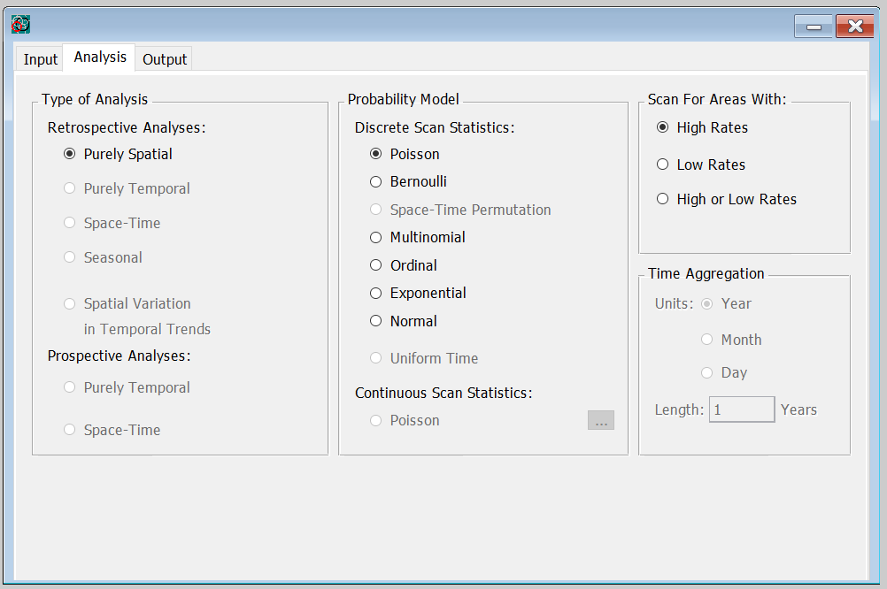
SaTScan Analysis

Slide 67
SaTScan Advanced Options
Check data for temporal extent
Check data for geographic extent
Define non-Euclidean spatial neighbors
Use network space

Slide 68
Generalized Estimating Equations
Not inferential: approximate relationships
Extension of GLM commonly applied to longitudinal panel data to account for dependency in a panel subject’s data over time
Assumes correlation within clusters and independence between clusters
Model Specification
Intra-cluster dependency matrix
Distribution
Link function

Slide 69

Discuss
This paper is very precise and clear… but…
Have we already learned more from researching its data sources and planning a workflow? What?
Do you notice any errors or missing information? If you were peer reviewing this study or planning to reproduce it, what more would you want to know?
Have you developed any concerns about the study?

Slide 70
Discuss
Pre-analysis plans and workflows are intended to increase transparency and keep researchers honest…
Does the “spatial is special” phrase apply to pre-analysis plan registration?
Are there ways in which spatial data and spatial analysis require additional attention to detail and scrutiny if pre-analysis planning is to support enhanced replicability?

Slide 71
Break
Do you have a Census API key?
Have you already installed the latest versions of R and RStudio?

Slide 72
Part IV: Execute a Computational Notebook in RStudio

Slide 73
RStudio & R Markdown Overview

Slide 74
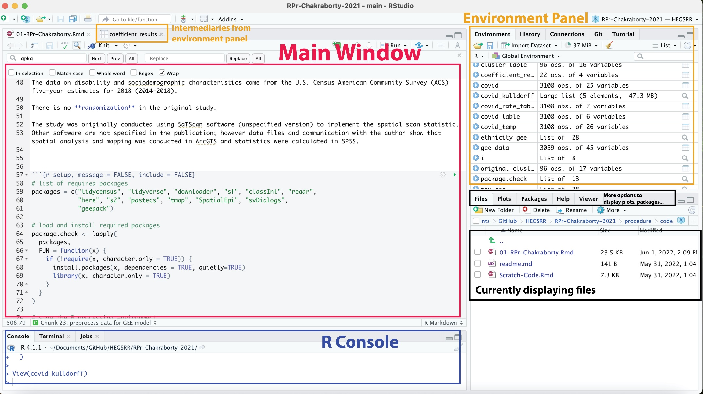
Rstudio: GUI for R

Slide 75
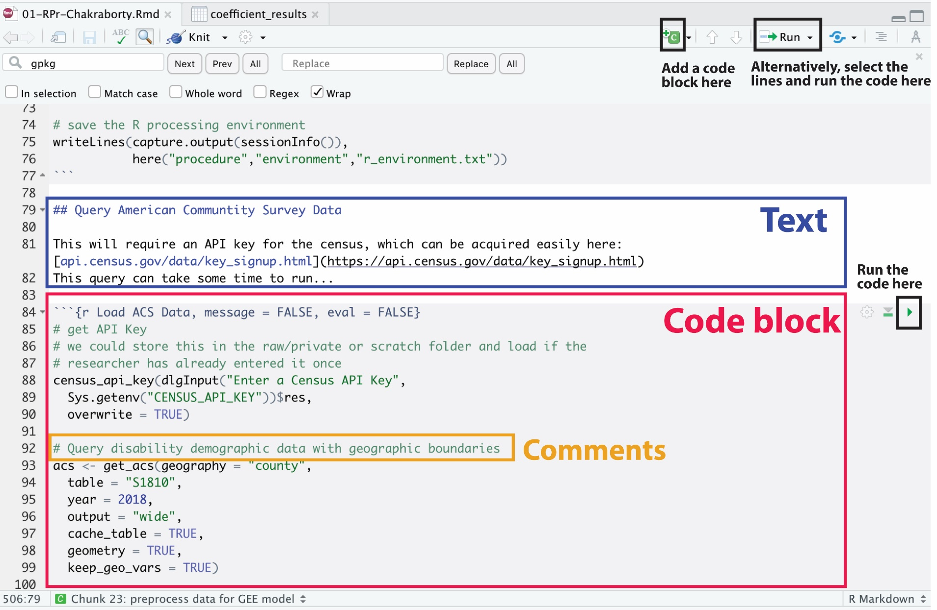
R Markdown Computational Notebook

Slide 76
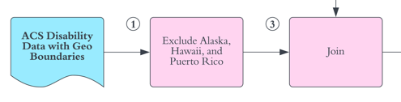
Reading R
filter and join acs data code block
# Remove Alaska, Hawaii & Puerto Rico
acs <- filter(acs, !STATEFP %in% c("02", "15", "72"))
# Join poverty data to disability data
acs <- left_join(acs, acs_pov, by = "GEOID")
Alternative with %>% piping
acs <- acs %>%
filter(!STATEFP %in% c("02", "15", "72") %>%
left_join(acs_pov, by = “GEOID”)

Slide 77
R / R Markdown Practices
open project in root directory of compendium to begin
load and install packages automatically (see our setup code block)
record the processing environment (see our setup code block)
use the here package for relative path names
write code in Rmarkdown or R scripts, not the console!
save API keys, passwords in local environment or scratch directory that is not version-tracked
use discrete code chunks that view & check results
Start with code to download data directly or through API
Save data so that code can run without downloading
save important inputs and results as individual objects in .rds files: Do not rely on the .RData file or objects stored in the environment
save figures with code, not manually
tidyverse style guide & helper functions for legible code
Knit Rmarkdown into PDF with LaTeX

Slide 78
Practice: Execute R Markdown Computational Notebook
Please follow along with the Workshop Technical Guide

Slide 79
Reproduction Study Results

Slide 80
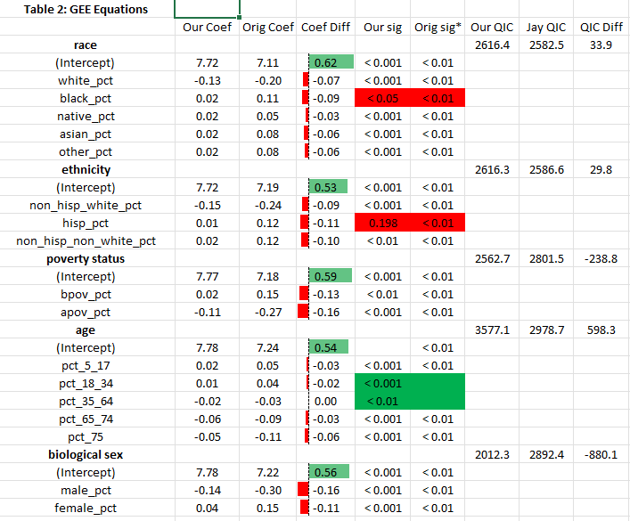
Comparing GEE Results

Slide 81
Reproduction Report
Append three sections to the pre-registered analysis plan
Results
Unplanned Deviations
Did you noticed any deviations from the research plan in the R Markdown notebook?
Discussion
Was this reproduction an exact success? Approximate success? Failure?
Why?

Slide 82
Discuss
This paper is very precise and clear… but…
Have we learned anything about Chakraborty’s study that we did not know based on the paper? What?
Can you imagine ways in which the reproduction study could be replicated, reanalyzed, or extended?

Slide 83
Beyond Reproduction
 | Same Methods | Varied Methods
Same Data | Reproduction (Verification) | Reanalysis
Different Data | (Direct) Replication | Extension

Slide 84
Discuss
Is there a future for R&R in human-environment and geographical sciences for you?
Are there specific ways you can imagine benefitting from R&R practices into your ongoing and future scholarly activity?
Are there specific barriers to adopting R&R practices into your ongoing and future scholarly activity?

Slide 85
Discuss
If we can work out R&R in geography, can you envision ways in which geography could contribute to other sciences or to convergent / interdisciplinary research?
Interest in trying a reproduction or replication project in a course you are teaching?

Slide 86
Appreciation
National Science Foundation
UCGIS
Jayajit Chakraborty
Peter Kedron
Research Assistants & Independent Studies: Kufre Udoh, Derrick Burt, Sarah Bardin, Drew An-Pham, Emily Zhou, Maddie Tango
We welcome feedback on all materials shared today! Email, Github Issue, or Pull Request!

